Slide 1
ML based String Matching
Mapping treatment for invoice data ingestion

Slide 2
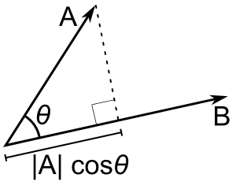

Cosine Similarity Algorithm
The cosine similarity between two vectors (or two documents on the Vector Space) is a measure that calculates the cosine of the angle between them.

Slide 3
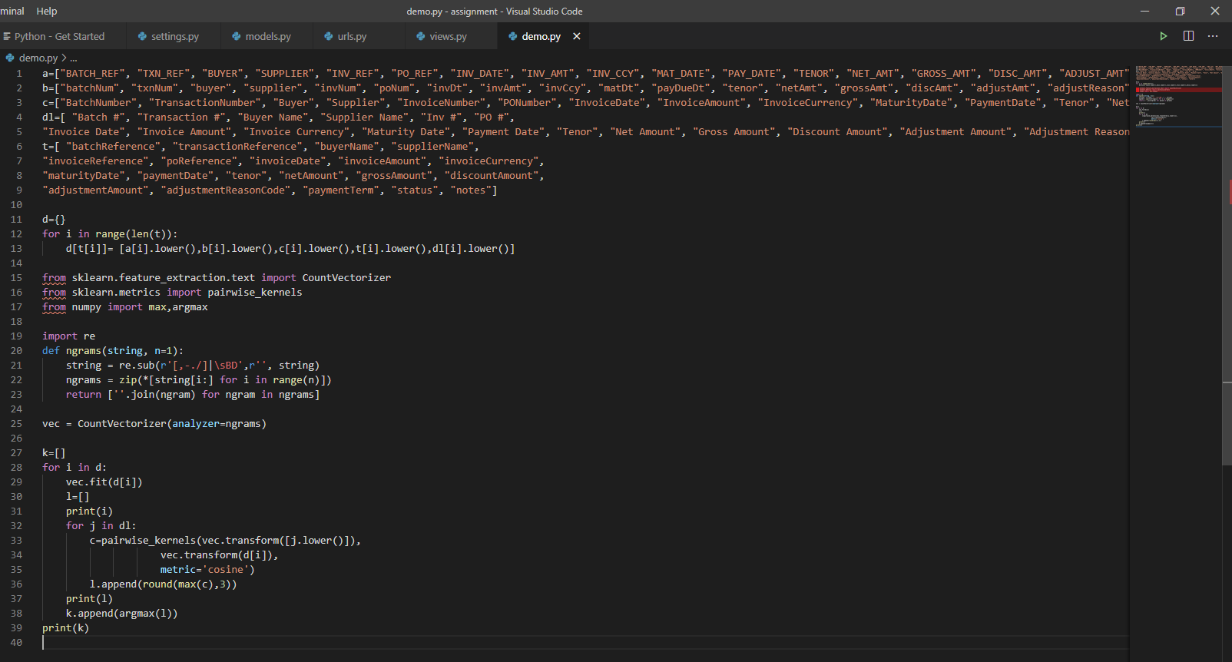
Design overview of Solution

